Slide 1
SOFTPRO INDIA COMPUTER TECHNOLOGIES PVT. LTD.
45-Day Internship in Agentic AI
and Generative AI with Python
Building real, deployed agentic & generative-AI applications — from Python foundations to a full capstone project
PRESENTED BY
UNIVERSITY
PRESENTED TO
Ayush Singh
Invertis University
Ms. Suhani Bhardwaj
MCA2025113
MCA Department
Internship Guide

Slide 2
About the Internship
A 45-day, hands-on AI Development Summer Training program by Softpro School of AI (Course code: SSAI-101), focused on Agentic AI and Generative AI with Python. The program follows a day-by-day, project-driven format — moving from core Python to production-style RAG and multi-agent systems, entirely on free-tier infrastructure.
46
Days of training
4
Phases of learning
3+1
Mini-projects + capstone
REPOSITORY
45-Days-LLM-Engineering
github.com/ayushsingh01894/45-Days-LLM-Engineering
Free-tier stack used throughout: Groq (primary LLM API) · Ollama (local models) · Hugging Face · Gemini · Chroma / pgvector + Supabase · Streamlit / Gradio · Langfuse · deployed on HF Spaces / Streamlit Cloud / Render.
45-Day Agentic AI & Generative AI Internship
2

Slide 3
Objectives of the Internship
1
Build strong Python foundations
2
Work hands-on with LLM APIs
Master core programming concepts before touching any AI/LLM tooling.
Make real API calls, engineer prompts, and integrate multiple LLM providers.
3
Master RAG & memory systems
4
Design agentic AI systems
Build semantic search and retrieval-augmented generation over real documents.
Use LangChain, LangGraph, CrewAI and AutoGen to build tool-using, multi-agent workflows.
5
Ship deployed, working apps
6
Build a placement-ready profile
Every phase ends in a runnable, demo-able mini-project — not just theory.
Combine technical skill-building with a parallel career/resume/portfolio track.
45-Day Agentic AI & Generative AI Internship
3

Slide 4
PHASE 1 · DAYS 1–15
Foundations
Days 1–7: a Python power-up. Days 8–15: first steps into the AI/LLM track.
Python Power-Up (Days 1–7)
Into AI/LLM Track (Days 8–15)
Data types, operators & variables
HTTP requests & async Python
Strings & f-strings
Environment config with dotenv
Conditionals & logical operators
Data validation with Pydantic
Loops (while / for / range)
First Groq API call
Functions, scope, *args/**kwargs
Prompt engineering techniques
Data structures: lists, dicts, tuples, sets
Multi-provider LLM patterns
Errors, modules & OOP
Streamlit for quick UIs
45-Day Agentic AI & Generative AI Internship
4

Slide 5
PHASE 2 · DAYS 16–20
RAG & Memory
01
02
03
04
05
CLI Chatbot
Embeddings
Semantic Search
Vector DB (Chroma)
Streamlit UI
Built a command-line chatbot with persistent conversation memory.
Learned how text embeddings represent meaning as vectors.
Implemented similarity-based search over document content.
Stored and queried embeddings using a Chroma vector database.
Wrapped the pipeline in an interactive Streamlit web app.
MINI-PROJECT 1
Chat With Your Documents — a working RAG app to ask natural-language questions over uploaded files.
45-Day Agentic AI & Generative AI Internship
5

Slide 6
PHASE 3 · DAYS 21–33
Agents & Tools
The core of agentic AI — from LangChain fundamentals to multi-agent orchestration.
1
2
3
LangChain Fundamentals
Tools & Function Calling
LangGraph & ReAct
LCEL, prompt templates, output parsers, memory.
Text-to-SQL agent — “Chat With Your Database”.
Graph-based reasoning and ReAct-style agents.
4
5
6
Multi-Agent Patterns
CrewAI & AutoGen
Observability & Guardrails
Sequential, supervisor & parallel agent workflows.
Alternative frameworks for collaborative agent teams.
Tracing with Langfuse; safety guardrails for agents.
Mini-Project 3: Research Agent — an autonomous agent that plans, searches and summarizes.
45-Day Agentic AI & Generative AI Internship
6

Slide 7
PHASE 4 · DAYS 39–46
Capstone & Placement
Capstone Build Sprint
Career Launchpad
1
Plan
A parallel 30-minute daily talk track, run alongside the technical curriculum.
Scope a full agentic/RAG application end-to-end.
Build-in-public habits
2
Build
Specialization strategy
Implement the capstone using the full stack learned across phases.
Resume & portfolio building
3
Deploy
Ship it live on a free-tier host (HF Spaces / Streamlit Cloud / Render).
Getting hired & winning clients
4
Demo
Present the working project on Demo Day.
45-Day Agentic AI & Generative AI Internship
7

Slide 8
Projects Built During the Internship
01
AI Content Summarizer
02
Chat With Your Documents
PHASE 1
PHASE 2
A Streamlit app that summarizes long-form content using multi-provider LLM APIs and prompt engineering.
A RAG application enabling natural-language Q&A over user-uploaded documents, powered by Chroma embeddings.
03
Chat With Your Database
04
Research Agent
PHASE 3
PHASE 3
A text-to-SQL agent that converts natural language into database queries using tool/function calling.
An autonomous multi-step agent built with LangGraph/CrewAI that plans, searches, and summarizes research.
45-Day Agentic AI & Generative AI Internship
8

Slide 9
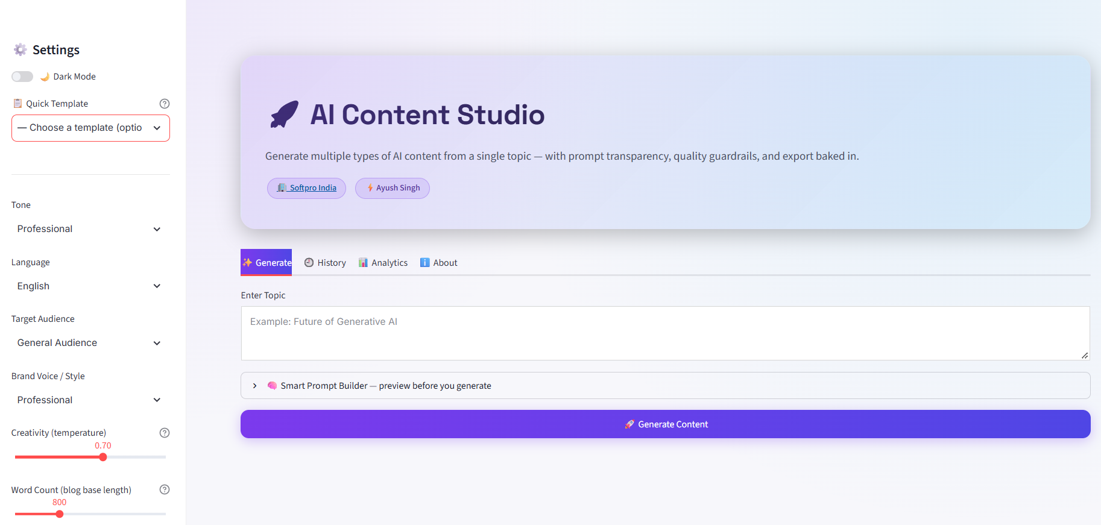
CAPSTONE PROJECT · DAYS 36–45
AI Content Studio
Independently conceptualised, built and deployed as the final capstone — a Streamlit app that turns one topic into 17 polished, ready-to-publish content formats.
Key Features
17 AI content types — blogs, social posts, emails, ads & more
Smart Prompt Builder — tone, audience, creativity, live preview
Groq LLM + LangChain (LCEL) for fast, chained generation
Content actions — Rewrite, Expand, Summarize, Humanize, SEO
Quality checks — AI-detection, readability & SEO analysis
LIVE APPLICATION
ai-content-studio-m8q2.onrender.com
Multi-format export — TXT, Markdown, DOCX & PDF
AI Content Studio — application interface
Tech stack: Python · Streamlit · Groq API · LangChain (LCEL) · python-docx · fpdf2
45-Day Agentic AI & Generative AI Internship
9

Slide 10
Skills & Key Learnings
Technical Skills
Professional Skills
Python programming (advanced)
Breaking large problems into daily milestones
LLM API integration (Groq, Gemini, HF, Ollama)
Reading & structuring project documentation
Prompt engineering
Debugging multi-provider API integrations
RAG pipelines & vector search
Building in public & documenting progress
LangChain / LangGraph / CrewAI / AutoGen
Presenting technical work clearly
Deployment on free-tier cloud platforms
Resume & portfolio building
45-Day Agentic AI & Generative AI Internship
10

Slide 11
Thank You
This 45-day internship gave me hands-on, end-to-end experience across the full Agentic AI & Generative AI stack — from Python foundations to deployed, agentic AI applications.
Ayush Singh · MCA2025113
Invertis University
Presented to Ms. Suhani Bhardwaj
45-Day Agentic AI & Generative AI Internship
11

